Slide 1
Self-Controlled-Window-& Curtain

Slide 2
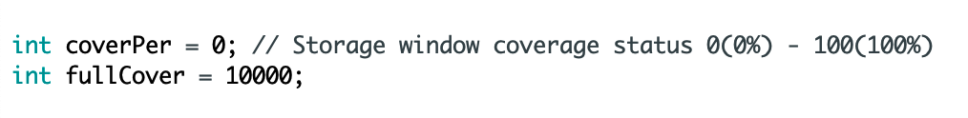
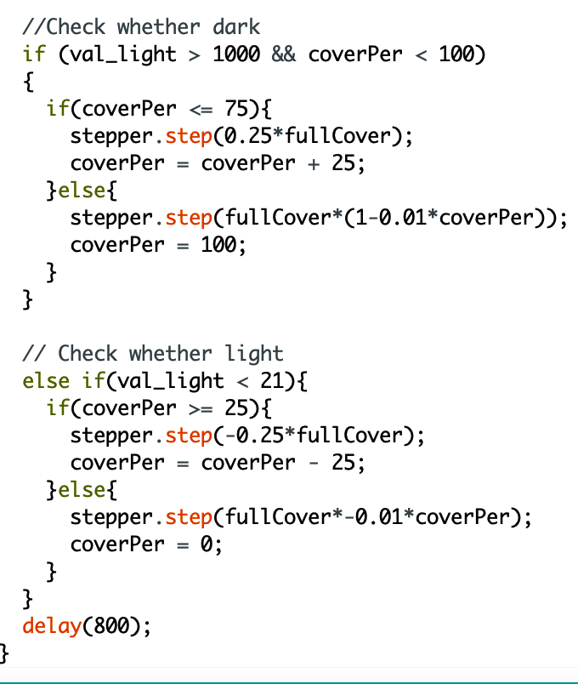
Working Process
1- Define the Initial state and finish state of the curtain.
2- Check the light, when the light is low the curtain will get down

Slide 3
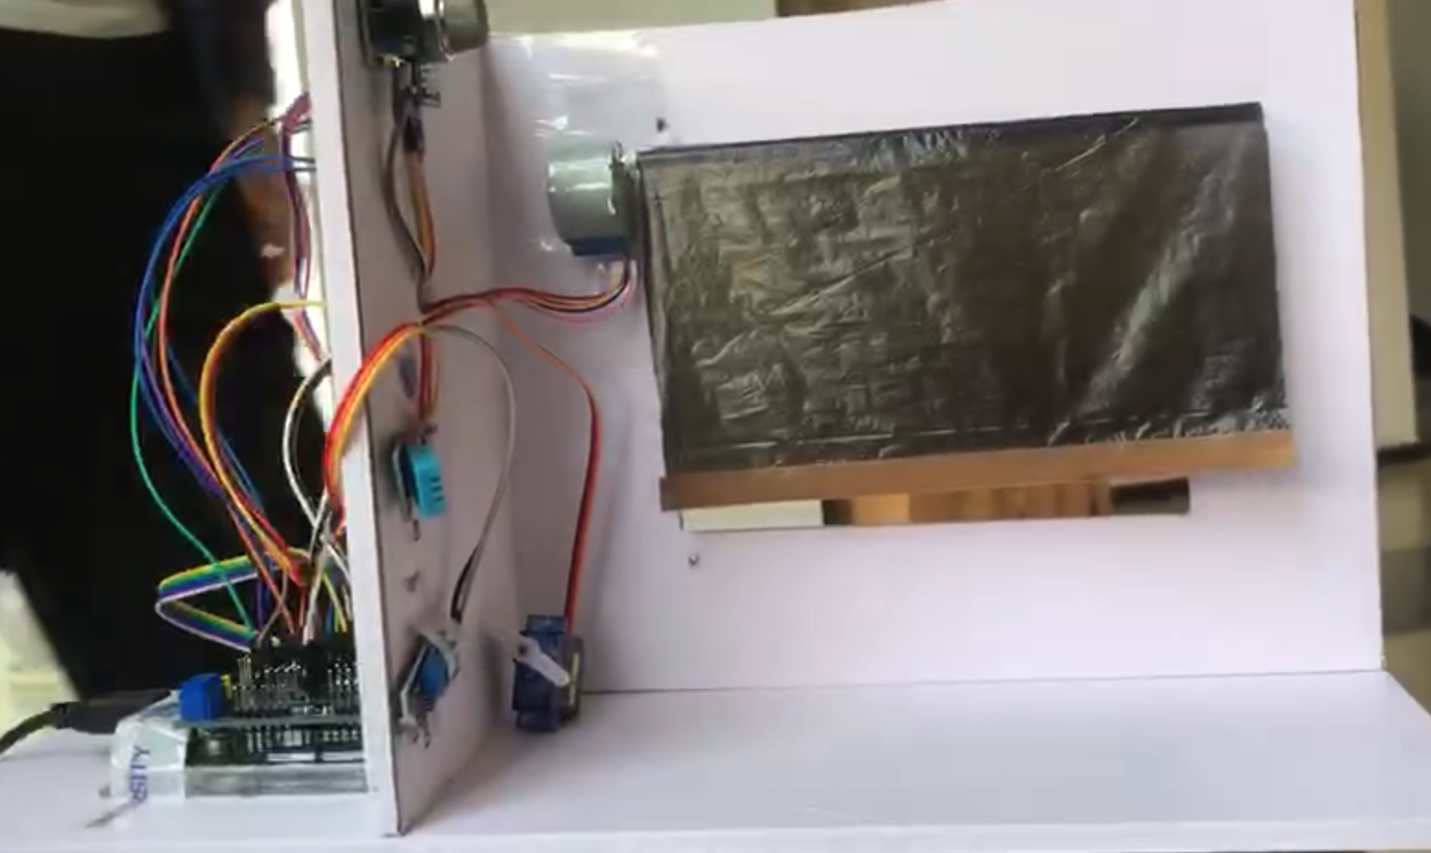
Improvement in outlook & Working
Much more stable & With quick motor compared with previous version

